Slide 1
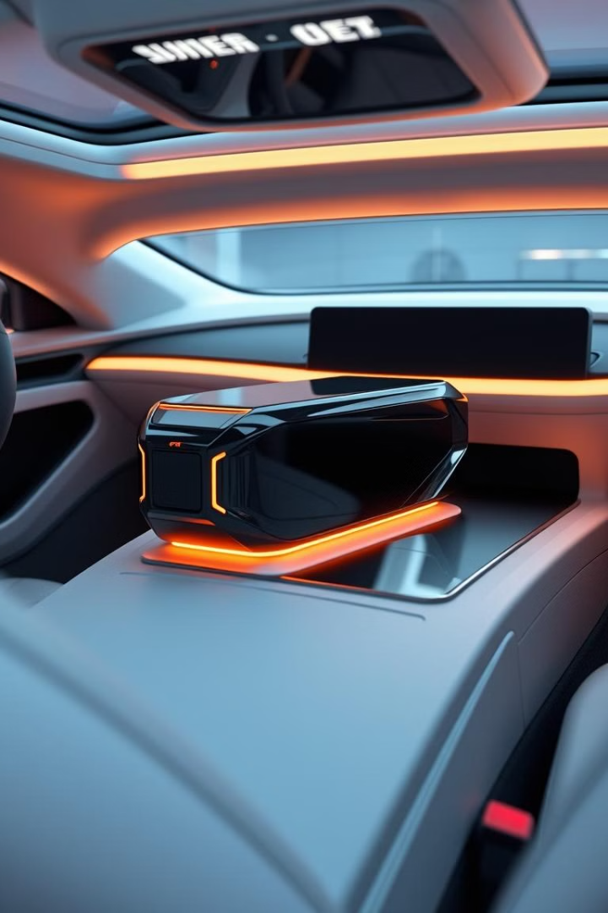
Car Black Box Project
Date: 19/2/2025
By BAYYA CHAITHANYA

Slide 2
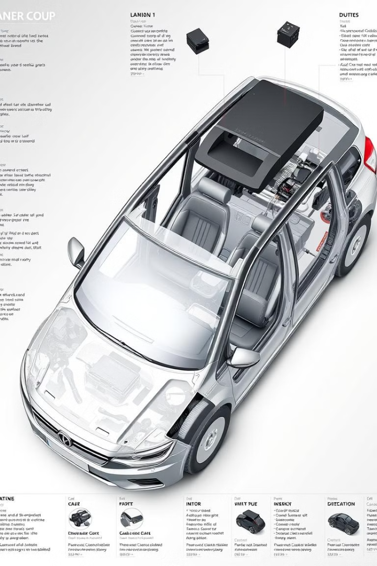
Project Contents
Introduction
Components
Role
Metrics
Advantages and disadvantages
Privacy
Future
Conclusion

Slide 3
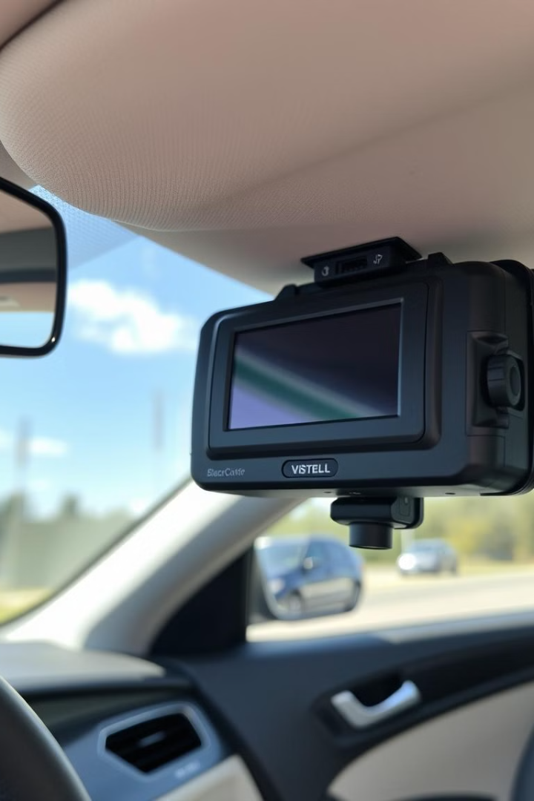
Introduction
A car black box is a data recorder that collect driving information
Before, during and after collision .It is also known as event data
recorder. The information collected includes speed, acceleration,
Braking, steering, and airbag activation. Black boxes may be
Physically installed in cars or downloaded in the firm of an app.
They are designed to be extremely robust, allowing them to
Survive collision and most other kinds of incidents a vehicle may
May be subjected to on the road.

Slide 4

Components
Hardware
Clcd
Matrix Keypad
External Eeprom
Adc
I2c
Uart
Software
I2c Protocol
Uart Protocol
MP Lab Ide

Slide 5
The Role Of Black Boxes In Accident
Investigation
Data Analysis
Black box data is crucial for accident reconstruction, providing detailed information about vehicle speed, direction, braking activity, and other
key factors. It helps investigators determine the cause of an accident, analyze driver behavior, and identify potential contributing factors.
Legal Evidence
Black box data can serve as critical legal evidence in court cases related to accidents, providing objective insights into the circumstances surrounding the event, aiding in liability assessment and legal proceedings .
Safety Improvement
By analyzing data from numerous accidents, manufacturers and safety agencies can gain insights into common accident patterns, leading to improved vehicle designs, safety features, and driver training programs.

Slide 6
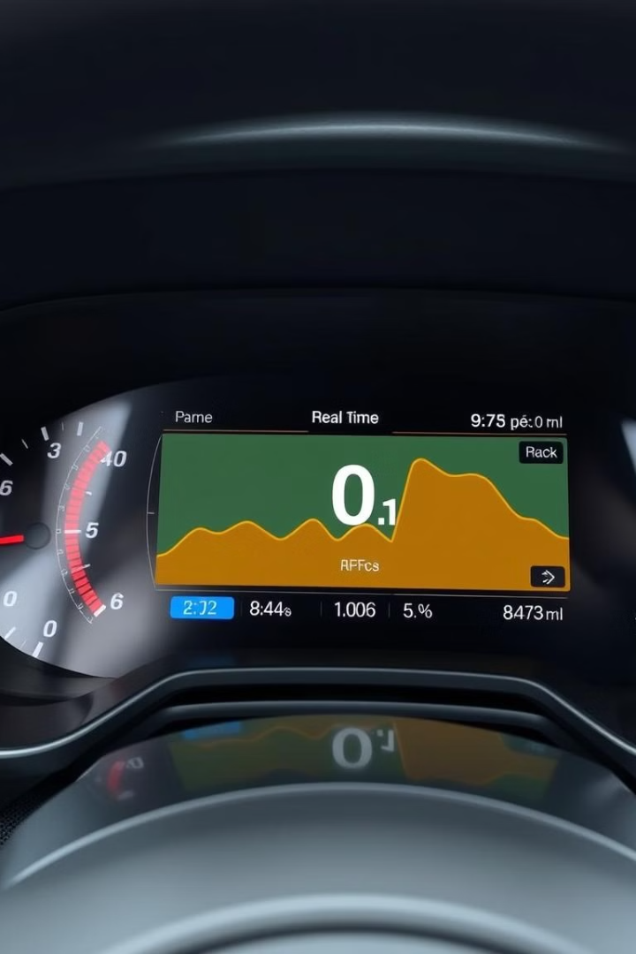
Metrics
Vehicle Speed
Precise recording of speed at regular intervals, providing a detailed history
of the vehicle's movement.
Acceleration And Braking
Information about the force and duration of acceleration and braking events, revealing driver behavior and potential for sudden maneuvers.
Engine Parameters
Recording of engine speed, throttle position, and other parameters, providing insights into engine performance and driver inputs.
GPS Location
Continuous tracking of vehicle location, enabling reconstruction
of the vehicle's path before and during an accident

Slide 7
Advantages and Disadvantages
Advantages
Disadvantages
Enhanced Safety: Data analysis can identify potential safety
hazards and contribute to accident prevention.
Improved Accident Investigation: Provides crucial evidence
for accident reconstruction and investigation.
Driver Behavior Insights: Can help drivers improve their driving
habits and promote safer driving practices.
Privacy Concerns: Raises ethical questions about data
collection and potential misuse of personal information.
Potential for Manipulation: Data can be tampered with or
misinterpreted, leading to inaccurate conclusions.
Cost Implications: Black box installation and data analysis can
add to the overall cost of vehicle ownership.

Slide 8

Privacy
Data collection raises privacy questions.
Regulations are needed to protect personal information.

Slide 9




Future of Technology
Enhanced Sensors
More detailed data collection.
AI Integration
Predictive safety features.
Connectivity
Real-time data sharing.

Slide 10

Conclusion
Car black box technology offers a promising future.
It enhances safety and accident investigation.

Slide 11


Thank You

